Slide 1



Data Integration for Species Distribution Models Under Spatial and Environmental Separation
Pablo Ubilla Pavez, Diego Marcos, Christophe Botella, Alexis Joly
pablo.ubilla-pavez@inria.fr
Notes:
There’s one more logo to add

Slide 2
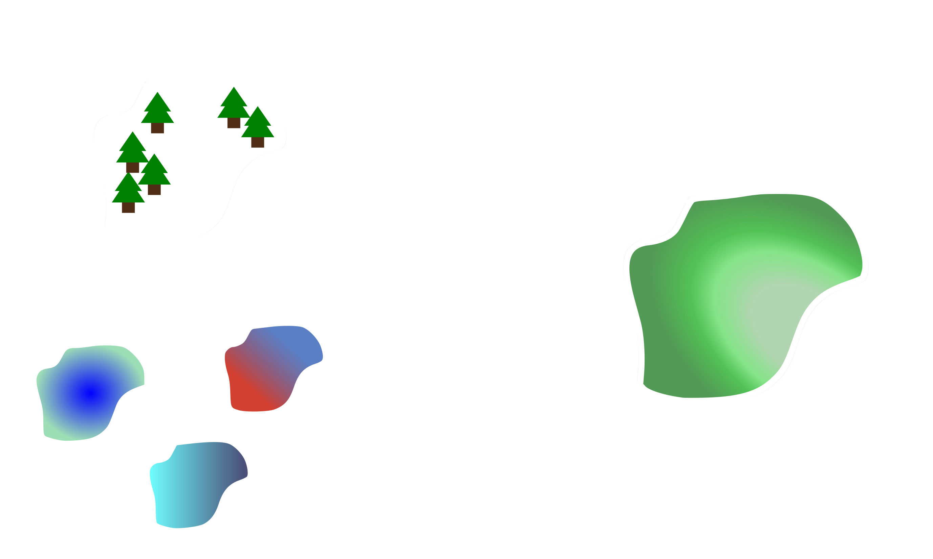
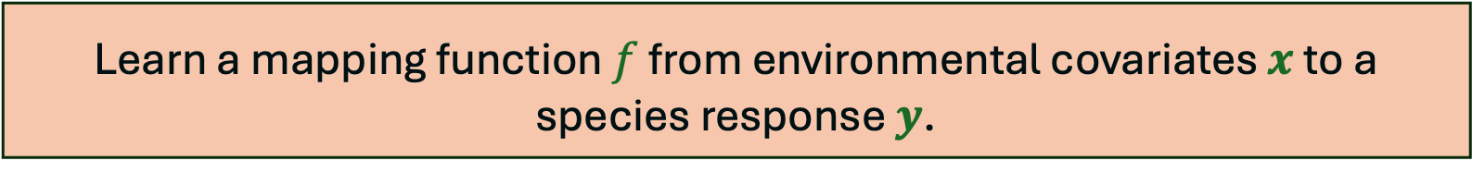



Species Distribution Model
Learn a mapping function $f$ from environmental covariates $x$ to a species response $y$.
Species
Observations ($y$)
Species distribution map
Temperature
Elevation
Train $f\left(x\right)=\hat{y}$
Environmental
Covariates ($x$)
Precipitation

Slide 3



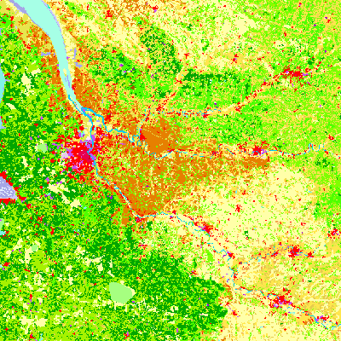
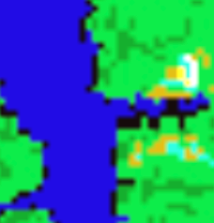

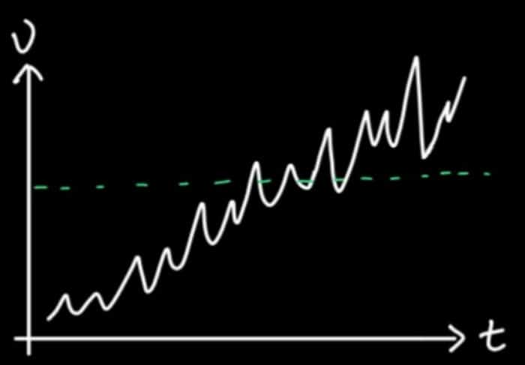

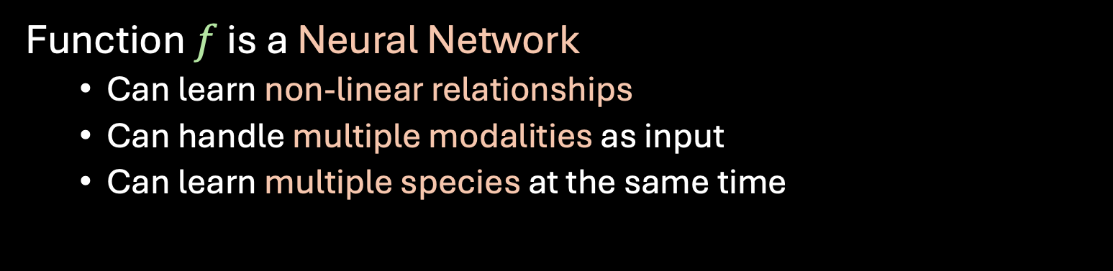
Deep Species Distribution Models
Function $f$ is a Neural Network
  Can learn non-linear relationships
  Can handle multiple modalities as input
  Can learn multiple species at the same time

Slide 4
Which kind of data feeds these models?

Slide 5
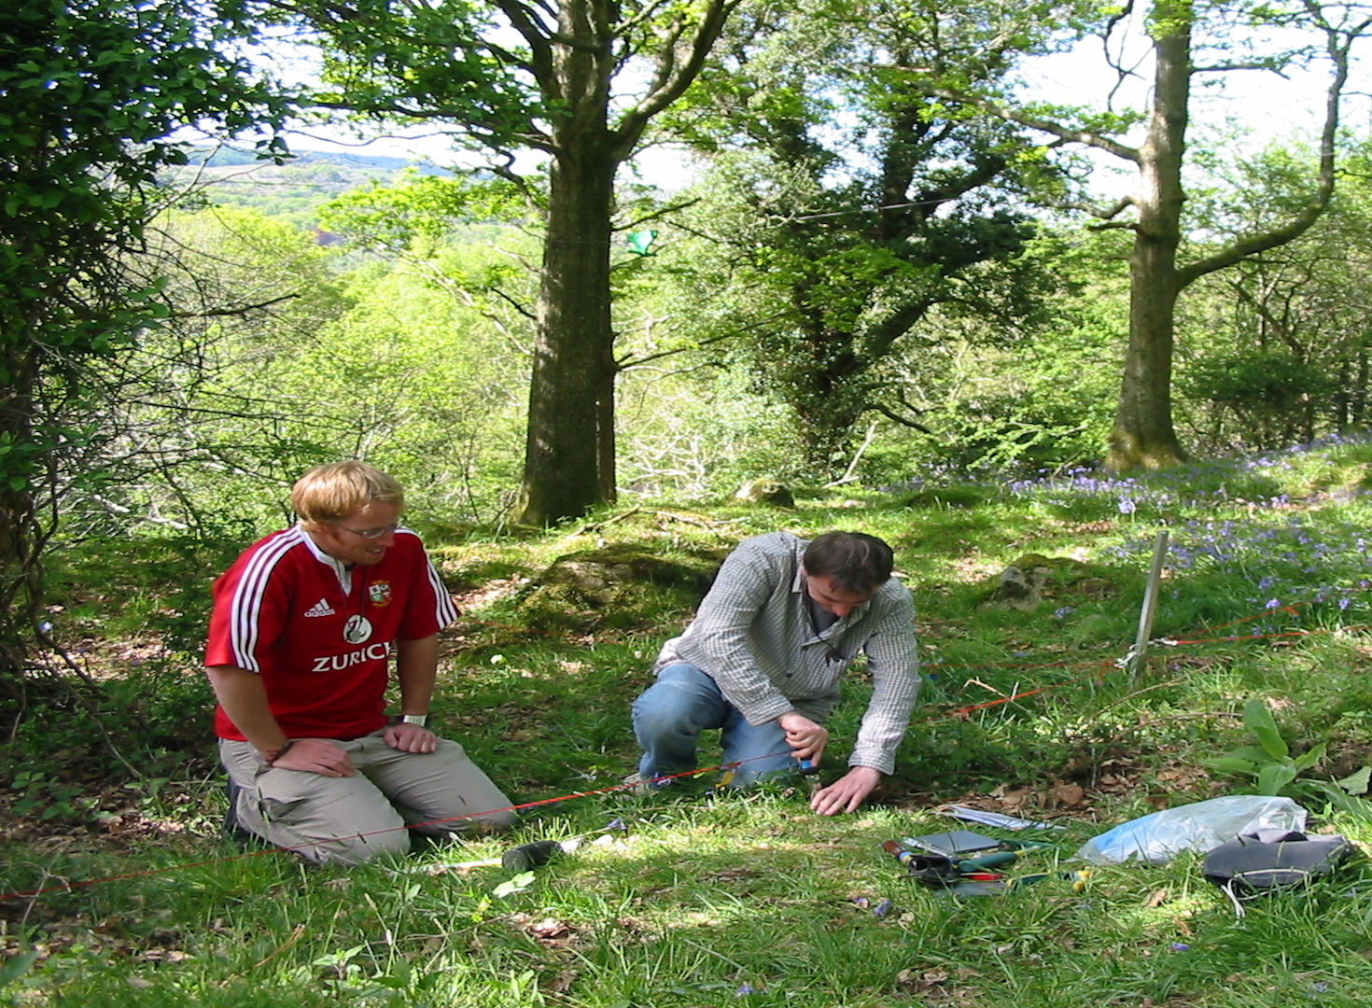

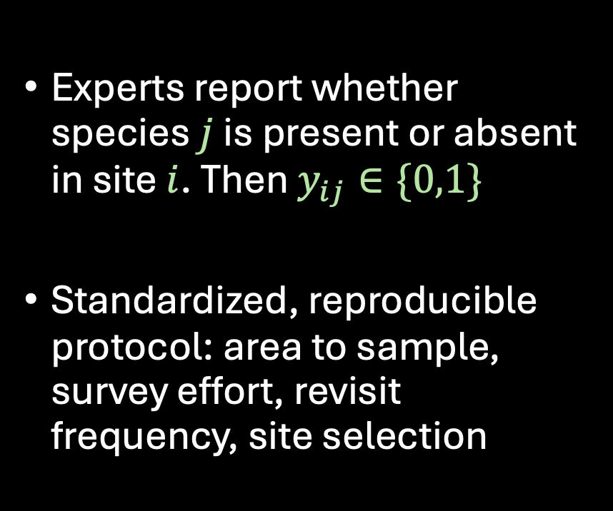
Presence Absence (PA) Data
Experts report whether species $j$ is present or absent in site $i$. Then $y_{ij}∈\{0,1\}$
Standardized, reproducible protocol: area to sample, survey effort, revisit frequency, site selection

Slide 6


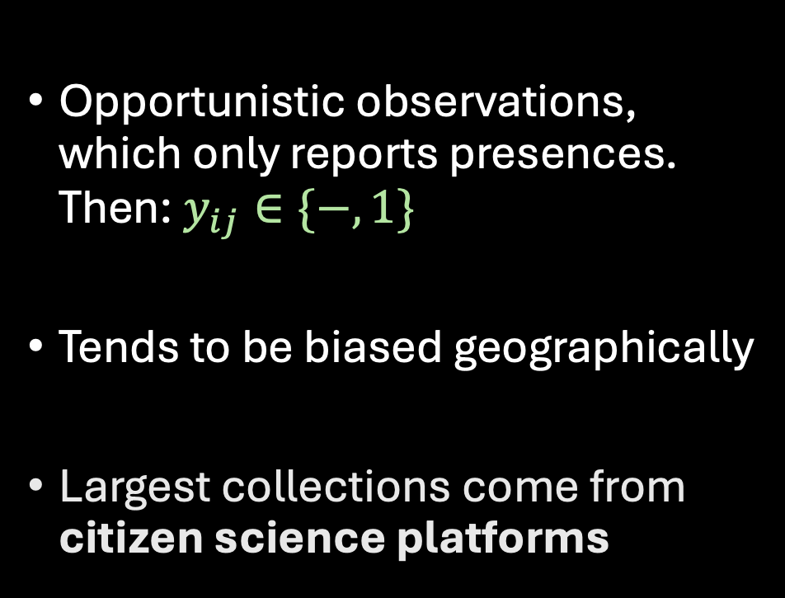
Presence Only (PO) Data
Opportunistic observations, which only reports presences. Then: $y_{ij}∈\{−,1\}$
Tends to be biased geographically
Largest collections come from citizen science platforms

Slide 7
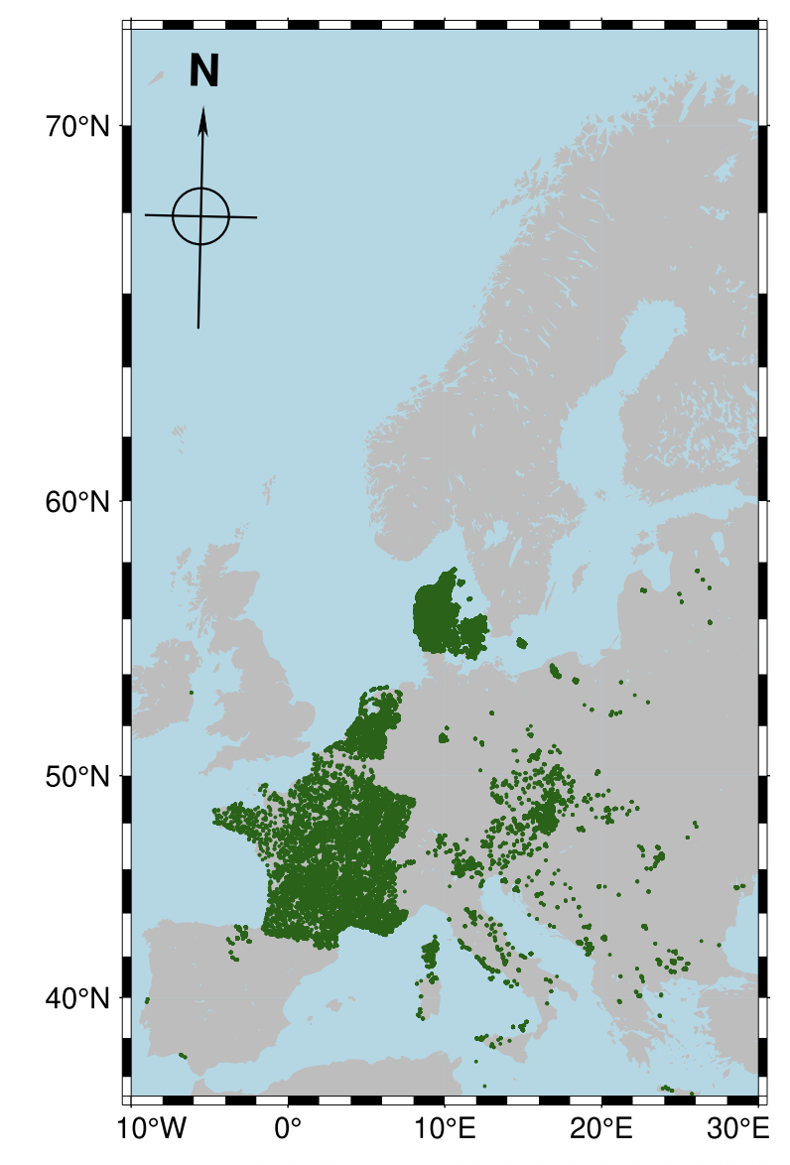
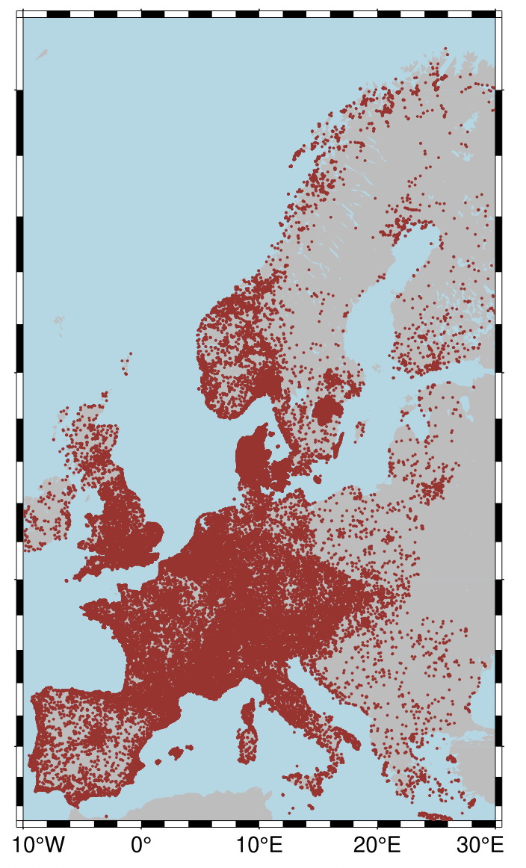
Data Availability
PA-Data
PO-Data
PA data is geographically limited, costly to collect, but far more valuable for reliable inference
PO data has much wider geographical coverage, but comes with significant biases
GeoLifeClef 2023 (Botella et al.)
Notes:
This should be the motivation (start with DI for extrapolation)

Slide 8
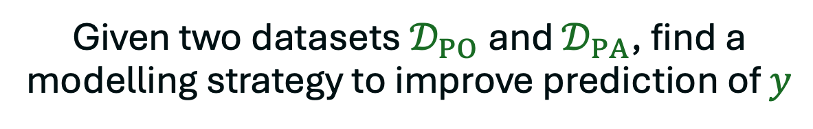
Data Integration in SDMs
Given two datasets $𝒟_{PO}$ and $𝒟_{PA}$, find a modelling strategy to improve prediction of $y$

Slide 9
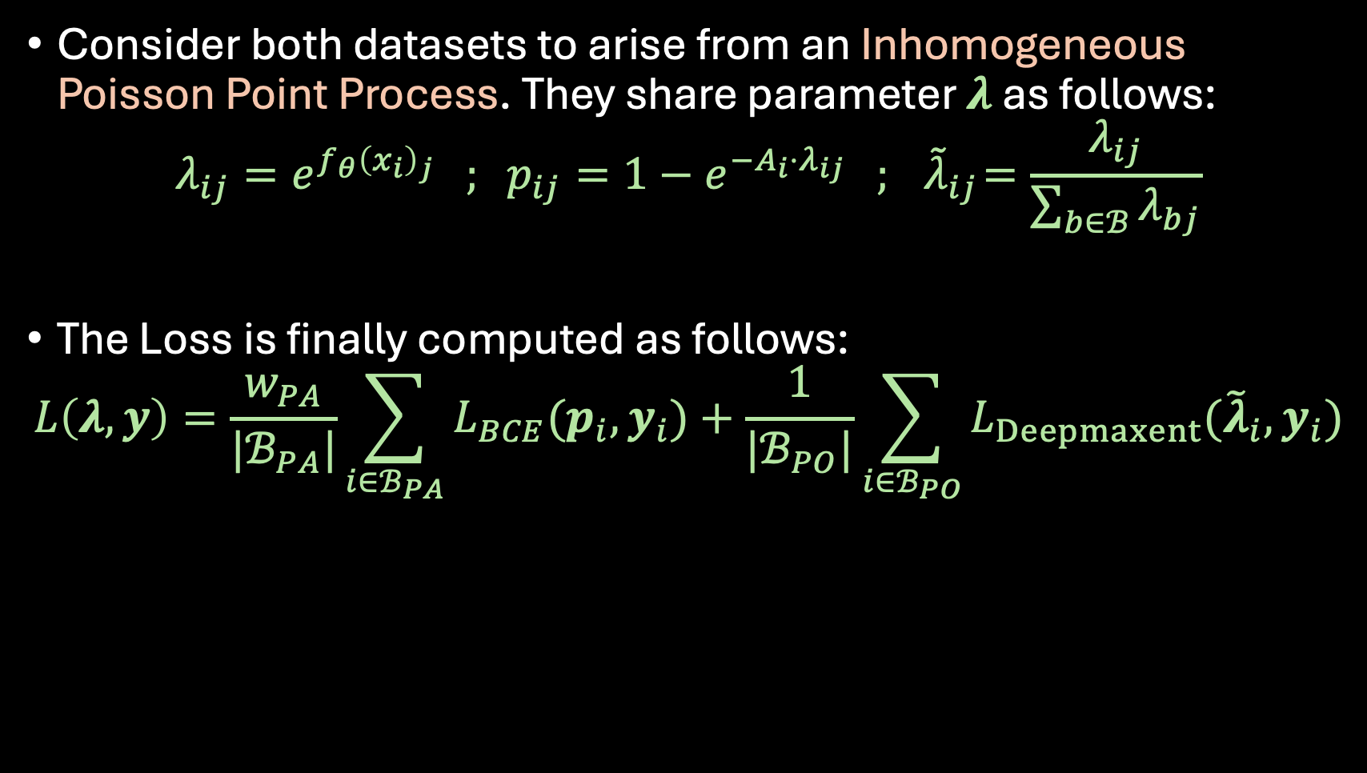
Proposed Approach
Consider both datasets to arise from an Inhomogeneous Poisson Point Process. They share parameter $λ$ as follows:
$$λ_{ij}=e^{f_{θ}{\left(x_{i}\right)}_{j}} ; p_{ij}=1−e^{−A_{i}⋅λ_{ij}} ; { \tilde{λ}}_{ij}=\frac{λ_{ij}}{\sum_{b∈ℬ}{λ_{bj}}}$$
The Loss is finally computed as follows:
$$L\left(λ,y\right)=\frac{w_{PA}}{|ℬ_{PA}|}\sum_{i∈ℬ_{PA}}{L_{BCE}(p_{i},y_{i})}+\frac{1}{|ℬ_{PO}|}\sum_{i∈ℬ_{PO}}{L_{Deepmaxent}({\tilde{λ}}_{i},y_{i})}$$

Slide 10
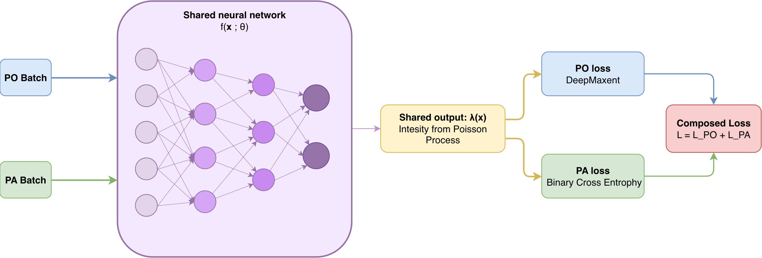
Proposed Approach

Slide 11
How can we test if data integration helps when PA data is not available?

Slide 12
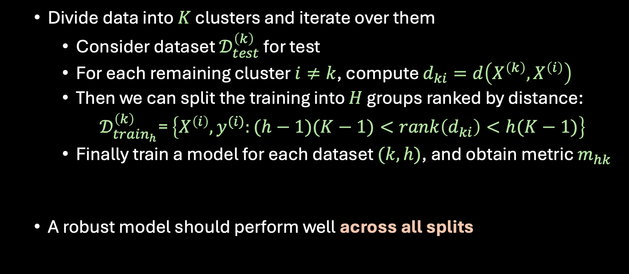
Evaluation Procedure
  Divide data into $K$ clusters and iterate over them
    Consider dataset $𝒟_{test}^{\left(k\right)}$ for test
    For each remaining cluster $i≠k$, compute $d_{ki}=d\left(X^{\left(k\right)},X^{\left(i\right)}\right)$
    Then we can split the training into $H$ groups ranked by distance:
    $𝒟_{train_{h}}^{\left(k\right)}$= $\left\{X^{\left(i\right)},y^{(i)}:(h−1)(K−1)<rank\left(d_{ki}\right)<h(K−1)\right\}$
    Finally train a model for each dataset $(k,h)$, and obtain metric $m_{hk}$
  A robust model should perform well across all splits

Slide 13
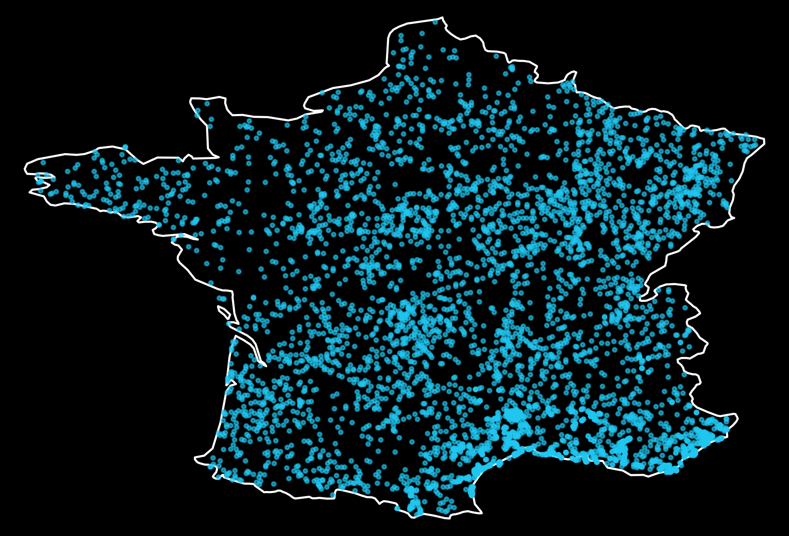

Slide 14
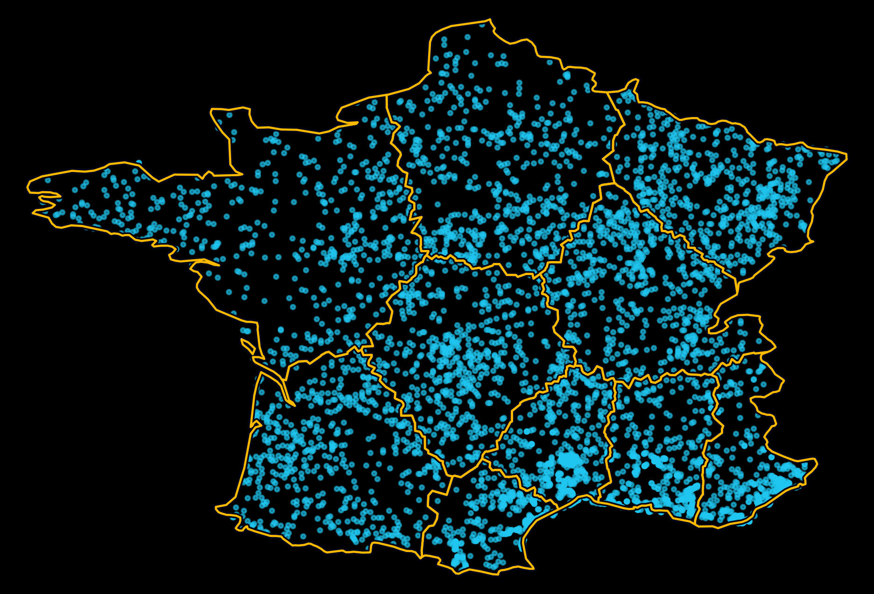
Divide space into equally sized clusters
(constrained K-means)

Slide 15
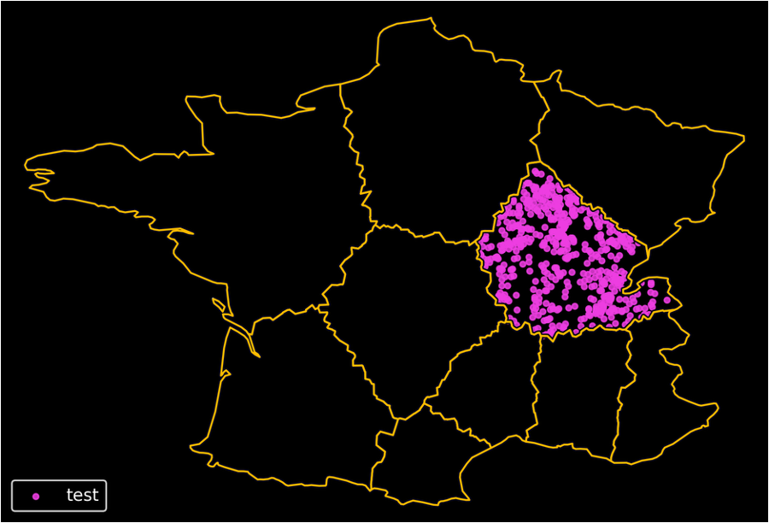
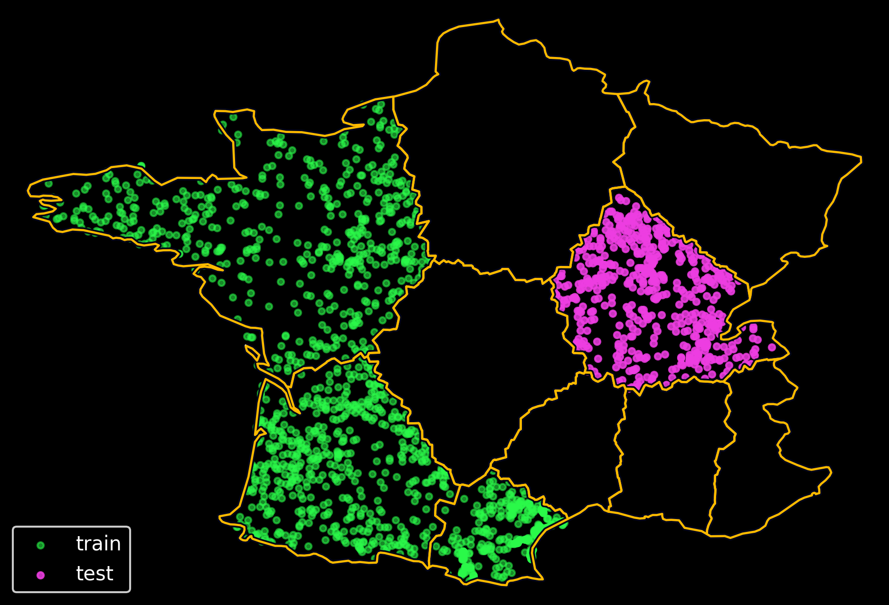
Closest percentile range
[0,0.33]
Farthest percentile range
(0.66,1]
Select one cluster for test

Slide 16
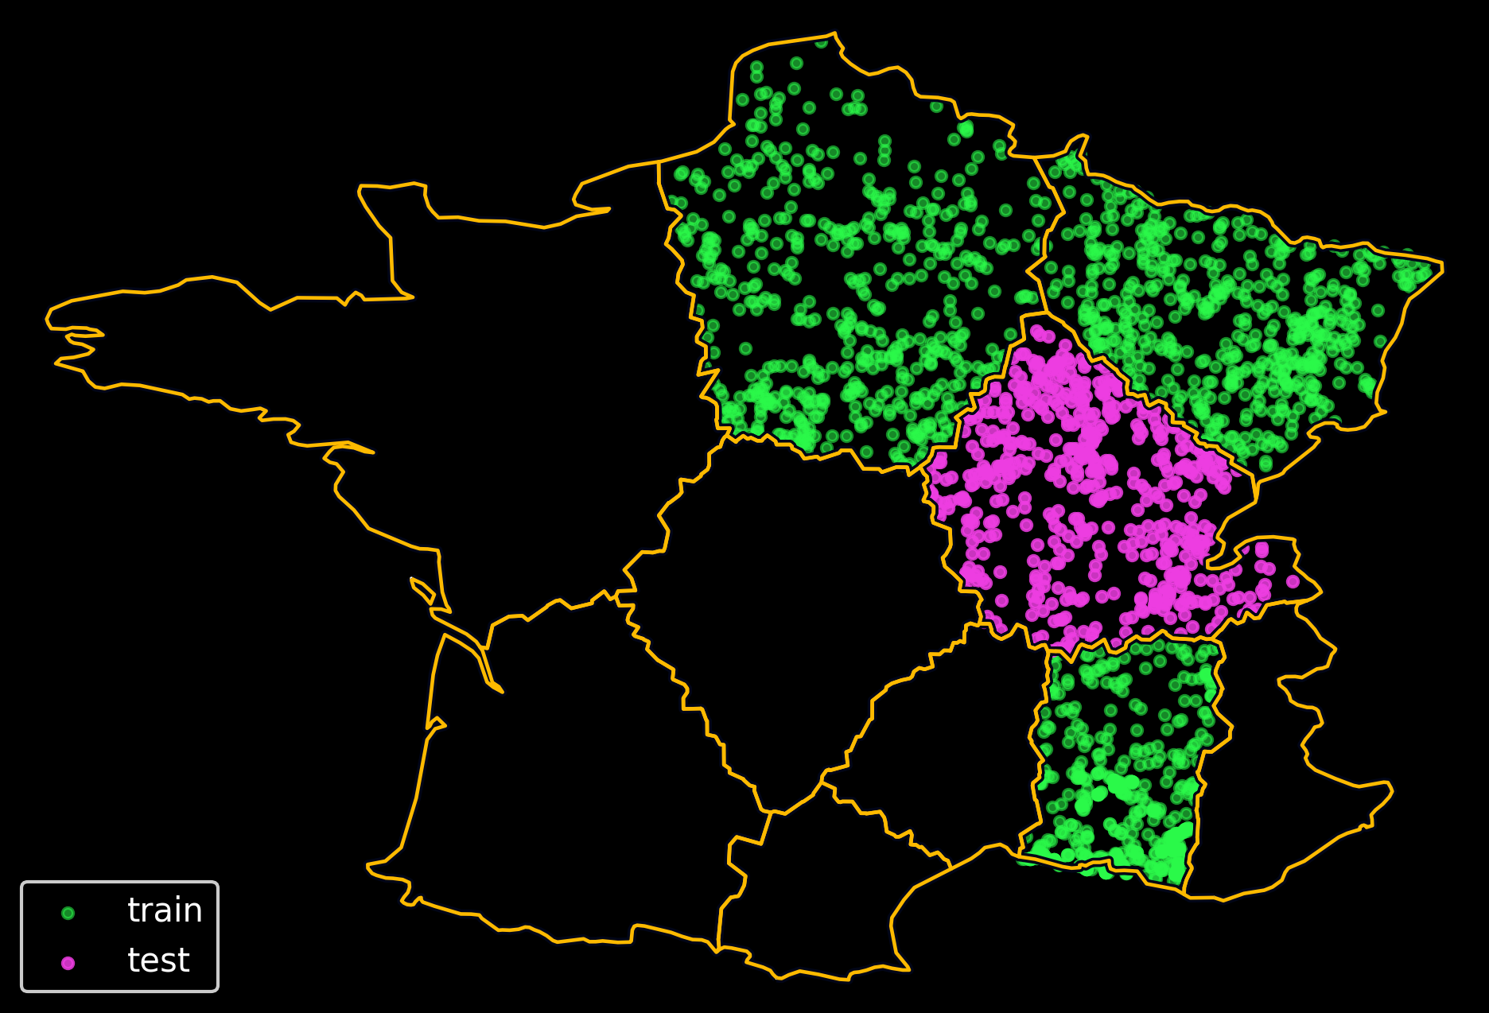
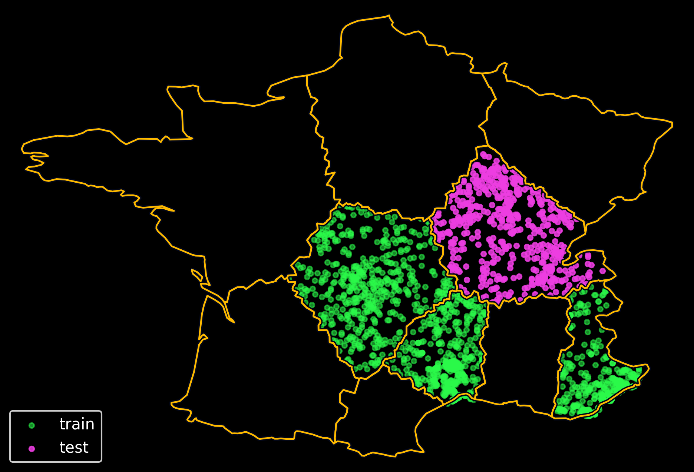

Closest percentile range
[0,0.33]
Middle percentile range
(0.33,0.66]
Farthest percentile range
(0.66,1]

Slide 17
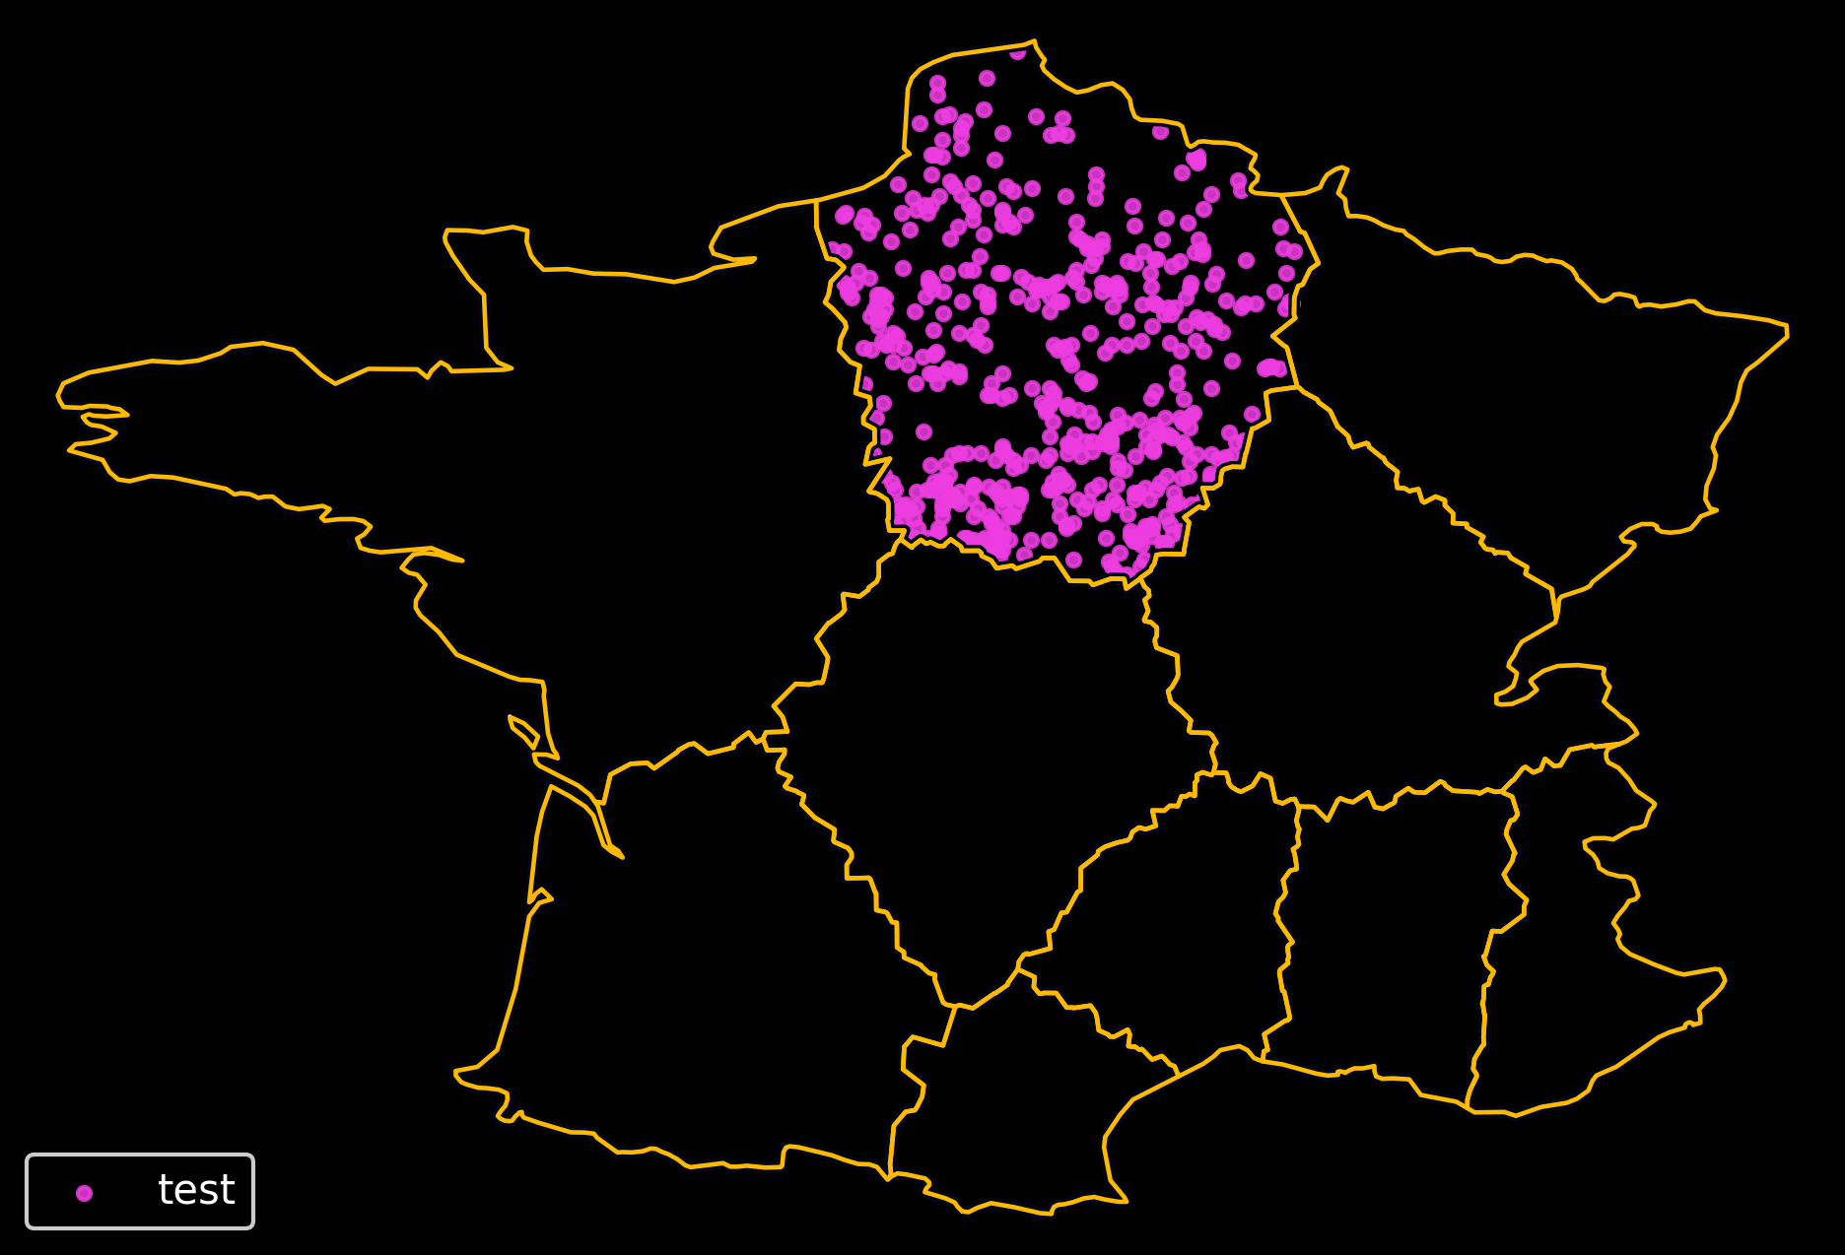
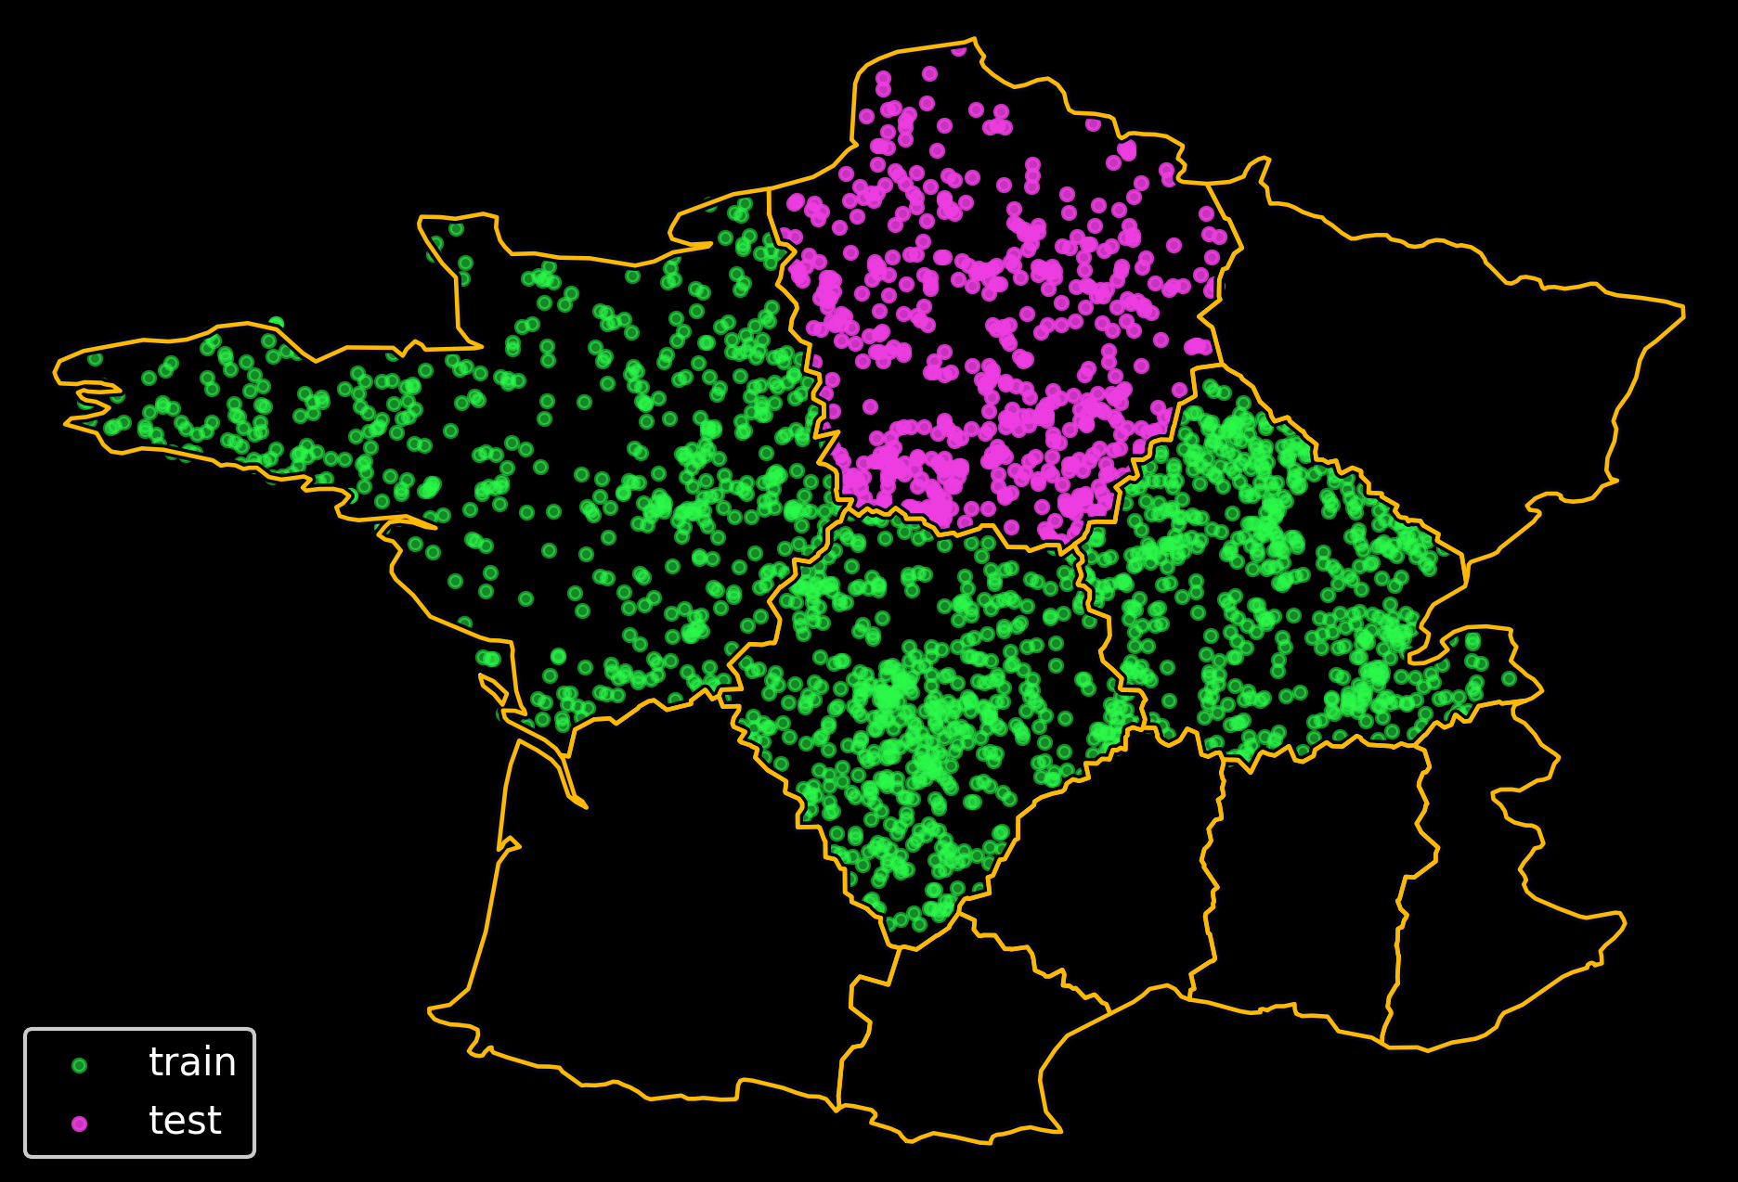
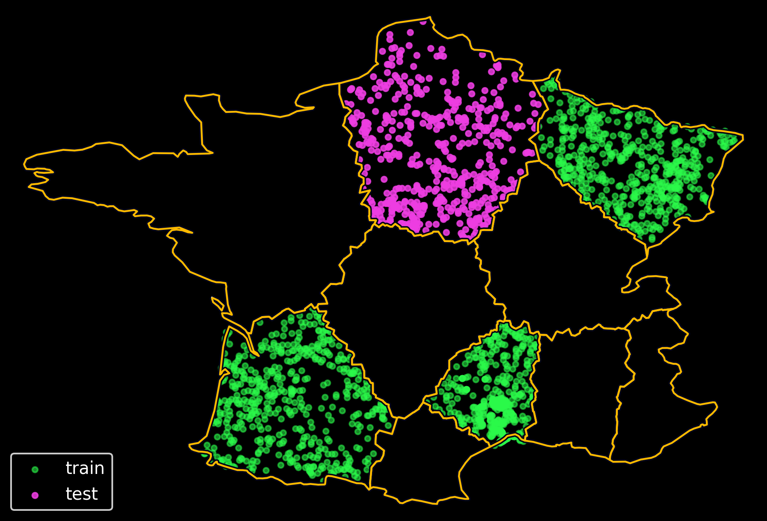
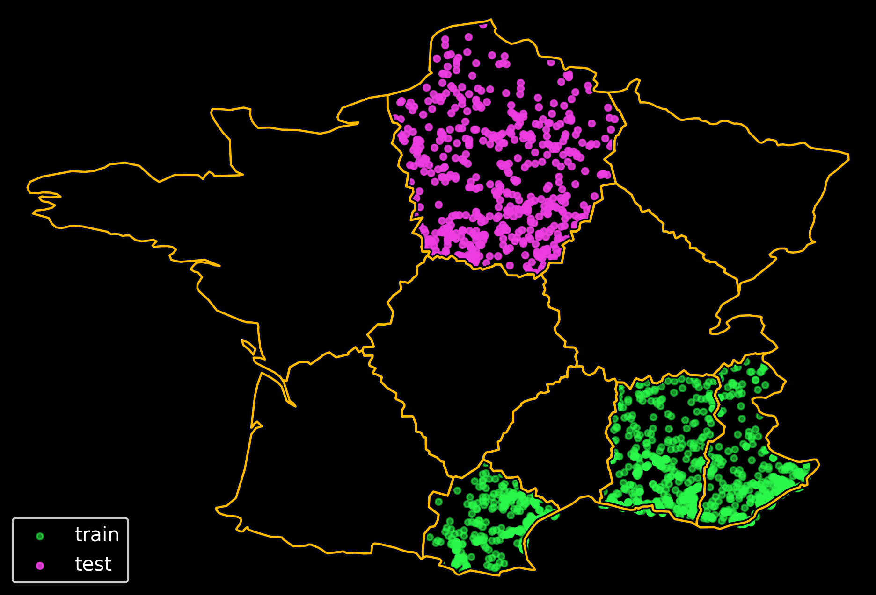
Closest percentile range
[0,0.33]
Middle percentile range
(0.33,0.66]
Farthest percentile range
(0.66,1]
Repeat test split
Choose another test set

Slide 18
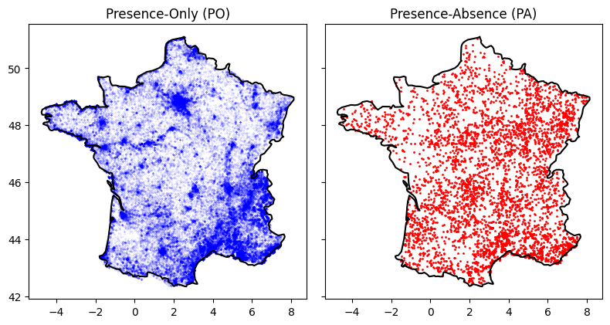
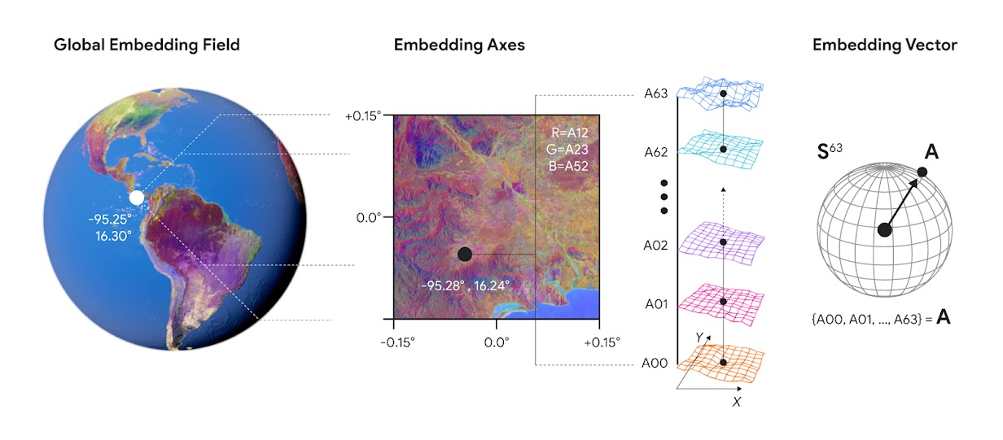
Case Study
Observations – GeoPlant subset in France
5K PA Plots | 80K PO Observations
1600 species
Covariates
Alpha Earth Embeddings
(64 bands)
Methods
PA Only: Binary Cross Entropy
PO Only: DeepMaxent
PA & PO: Binary Cross Entropy (Naive)
PA & PO: Integrated Loss
Notes:
Maybe this figure of PO and PA can go before and then show the split methods emphasizing is done in the PA

Slide 19
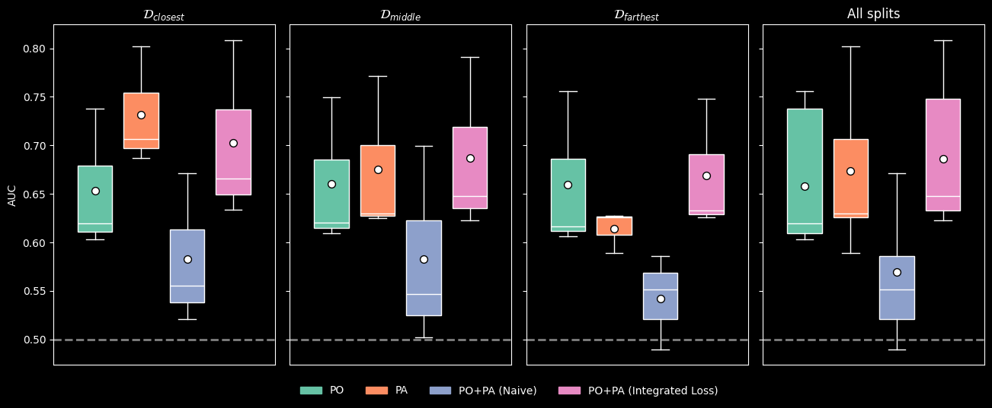
Results

Slide 20
Conclusions
Both PO Data (citizen science) and PA Data (controlled surveys) are valuable for SDMs
Models should account for the difference in the observation processes from each source
Citizen Science becomes more valuable in areas where controlled surveys are scarce

Slide 21
Many Thanks
Merci Beacoup
Muchas Gracias
pablo.ubilla-pavez@inria.fr

