Slide 1




Data Integration for Deep Species Distribution Models Under Spatial and Environmental Separation
Pablo Ubilla Pavez, Christophe Botella, Diego Marcos
pablo.ubilla-pavez@inria.fr

Slide 2
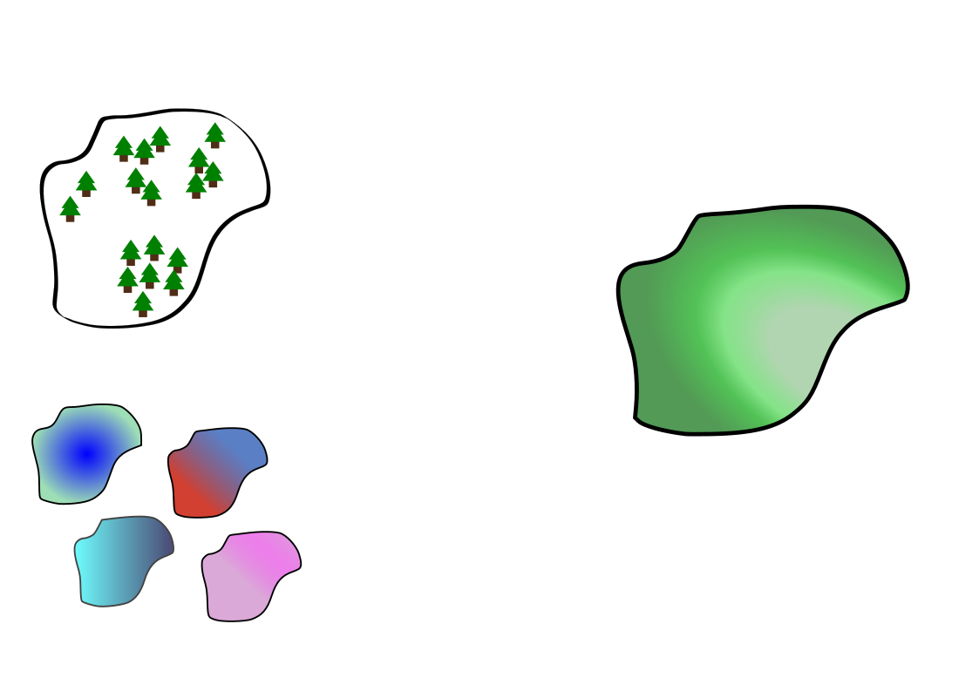
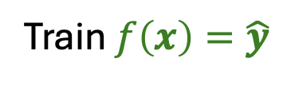

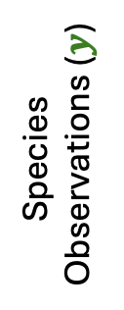
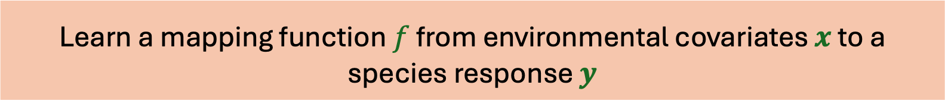
Species Distribution Model
Learn a mapping function $f$ from environmental covariates $x$ to a species response $y$
Species
Observations ($y$)
Train $f\left(x\right)=\hat{y}$
Elevation
Temperature
Species distribution map
Environmental
Covariates ($x$)
Cloud Cover
Precipitation

Slide 3



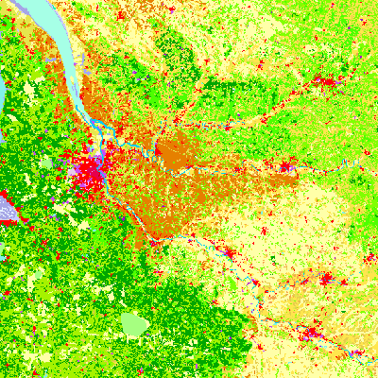
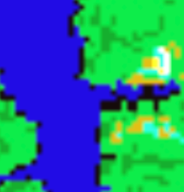

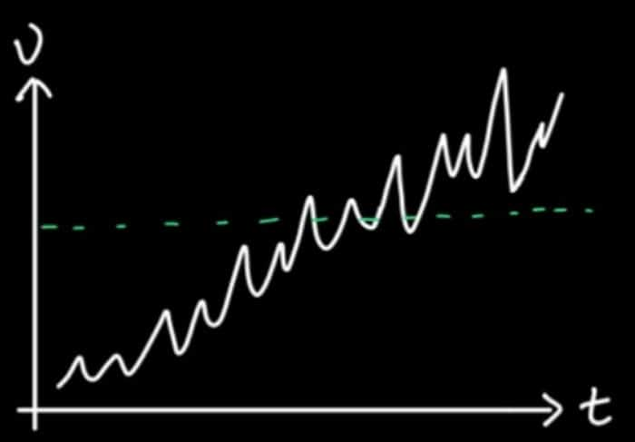

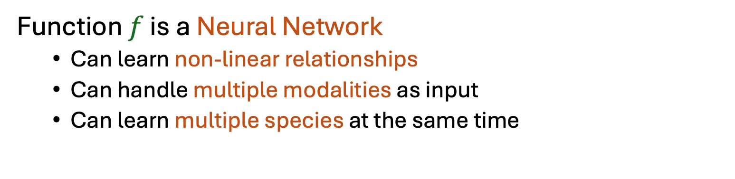
Deep Species Distribution Models
Function $f$ is a Neural Network
  Can learn non-linear relationships
  Can handle multiple modalities as input
  Can learn multiple species at the same time

Slide 4
Which kind of data feeds these models?

Slide 5
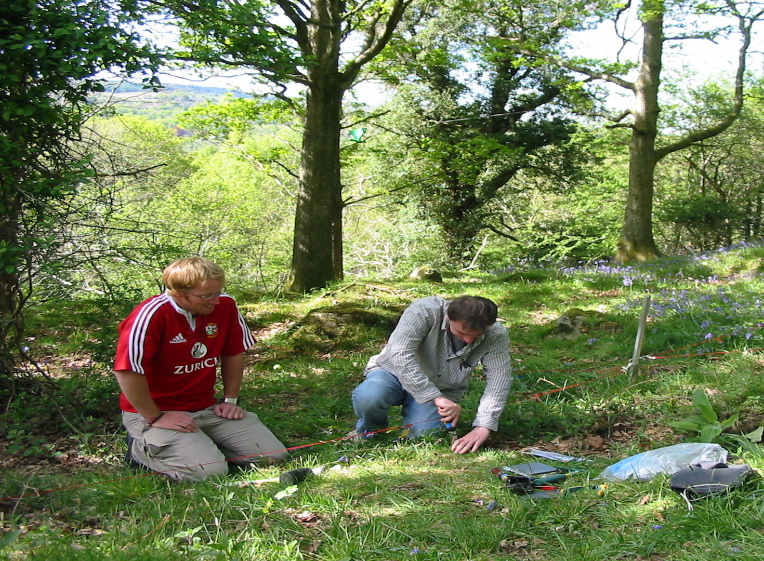

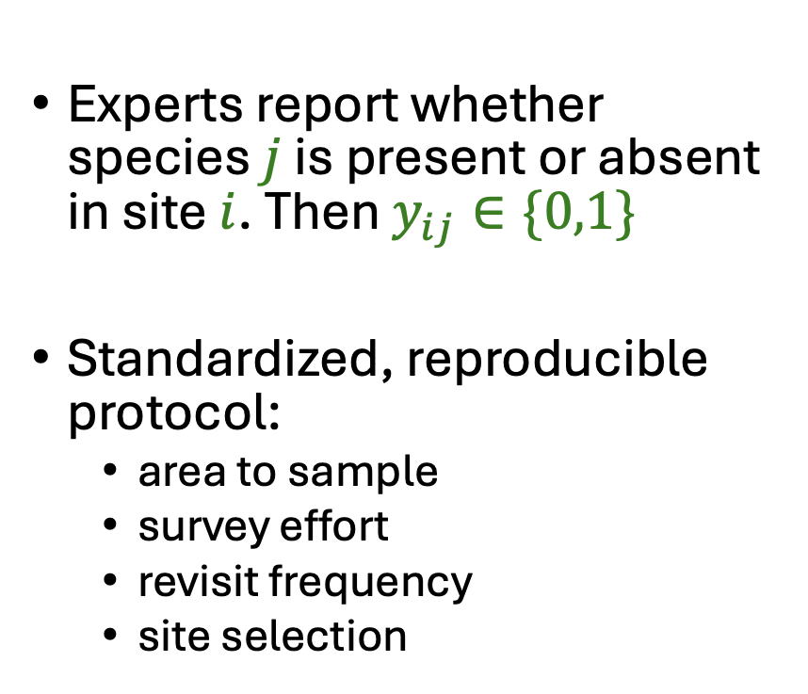
Presence Absence (PA) Data
Experts report whether species $j$ is present or absent in site $i$. Then $y_{ij}∈\{0,1\}$
Standardized, reproducible protocol:
  area to sample
  survey effort
  revisit frequency
  site selection

Slide 6
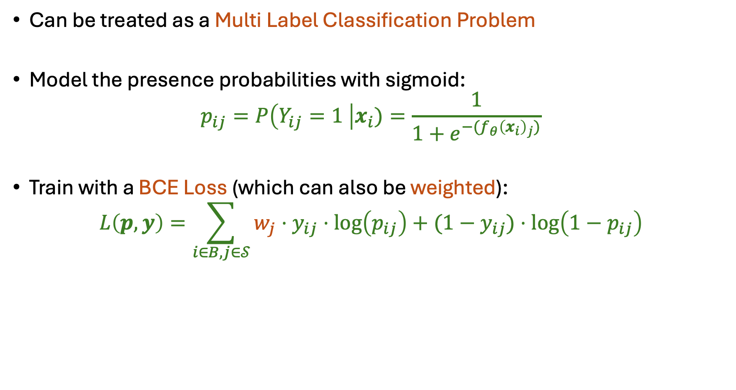
Model training with PA
Can be treated as a Multi Label Classification Problem
Model the presence probabilities with sigmoid:
$$p_{ij}=P\left(Y_{ij}=1 \right|x_{i})=\frac{1}{1+e^{−(f_{θ}{\left(x_{i}\right)}_{j})}}$$
Train with a BCE Loss (which can also be weighted):
$$L\left(p,y\right)=\sum_{i∈B,j∈𝒮}{{w_{j}⋅y}_{ij}⋅\log\left(p_{ij}\right)+{(1−y}_{ij})⋅\log\left(1−p_{ij}\right)}$$

Slide 7

PA Data is super cool.
What if we do not have it?

Slide 8


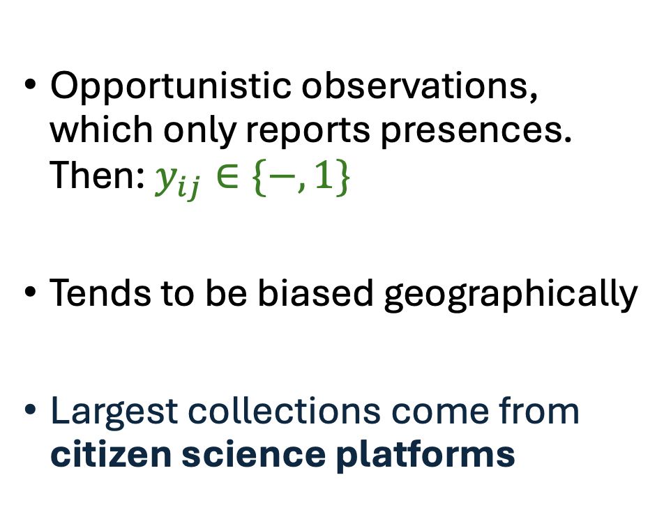
Presence Only (PO) Data
Opportunistic observations, which only reports presences. Then: $y_{ij}∈\{−,1\}$
Tends to be biased geographically
Largest collections come from citizen science platforms

Slide 9
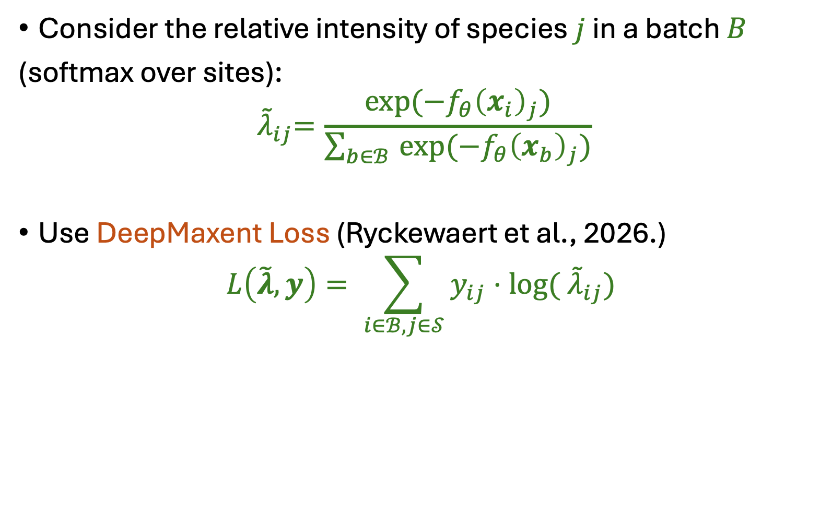
Model training with PO
Consider the relative intensity of species $j$ in a batch $B$
(softmax over sites):
$${ \tilde{λ}}_{ij}=\frac{exp⁡({−f}_{θ}{\left(x_{i}\right)}_{j})}{\sum_{b∈ℬ }{exp⁡(−f_{θ}{\left(x_{b}\right)}_{j})}}$$
Use DeepMaxent Loss (Ryckewaert et al., 2026.)
$$L\left(\tilde{λ},y\right)= \sum_{i∈ℬ,j∈𝒮}{y_{ij}⋅log⁡({ \tilde{λ}}_{ij})}$$

Slide 10

OK, maybe PO is cool too.
Download
!!!

Slide 11

Data Integration in SDMs
Given two datasets $𝒟_{PO}$ and $𝒟_{PA}^{train}$, find a modelling strategy to improve prediction in $𝒟_{PA}^{test}$

Slide 12
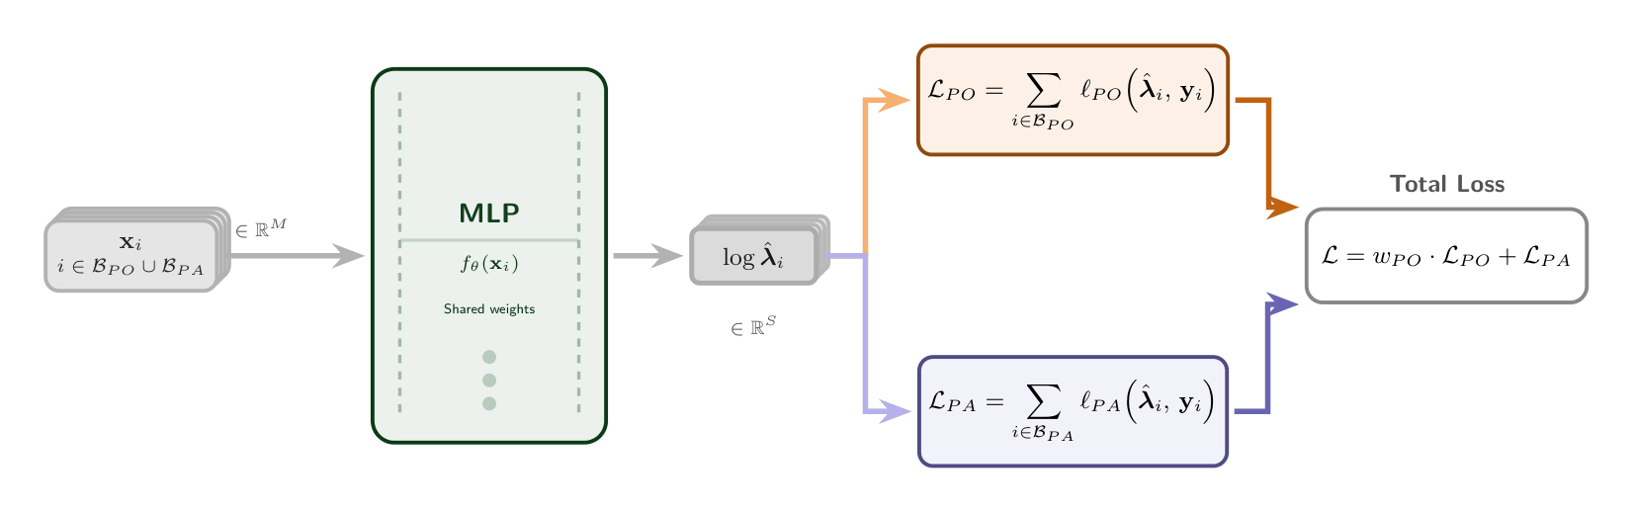
Proposed Approach
Sources share a Neural Network
Depending on the source the output can go to a different Loss

Slide 13
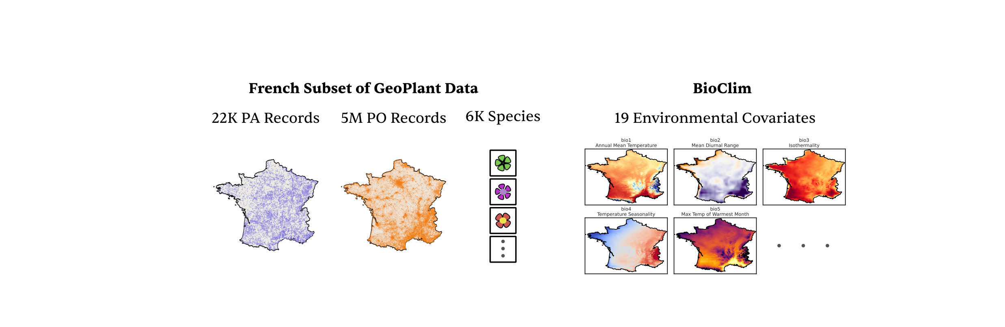
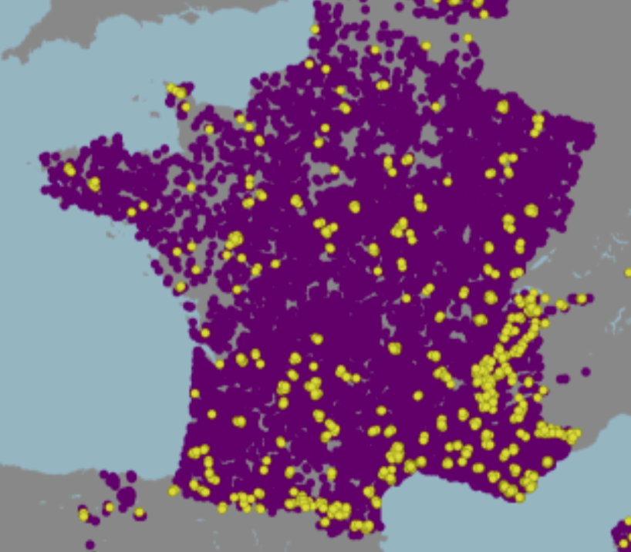
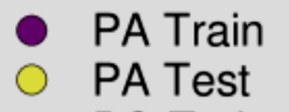
Case Study
French Subset Geoplant
Bioclim
>22K
PA Surveys
>1M PO
Records
>6K
Species
19 Environmental Covariates
Original train-test split from Geoplant

Slide 14
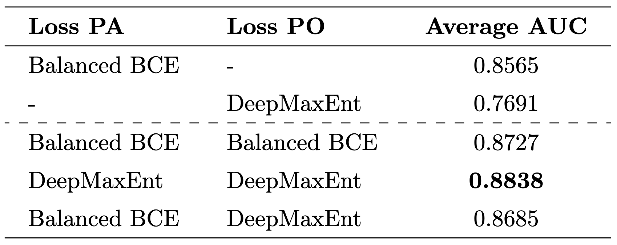
Results
Single
Source
Combined
Source
Integration helps but it can be (relatively) naive

Slide 15
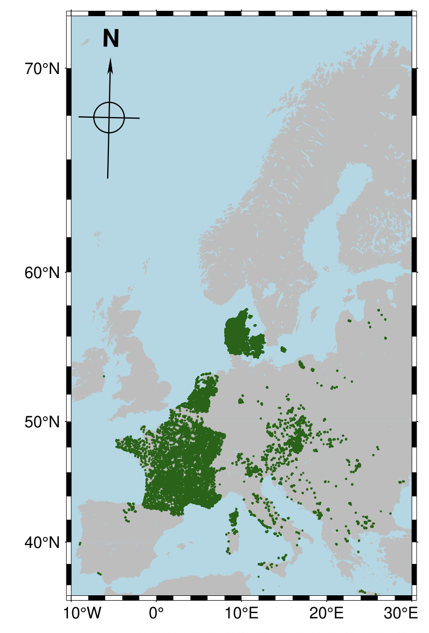
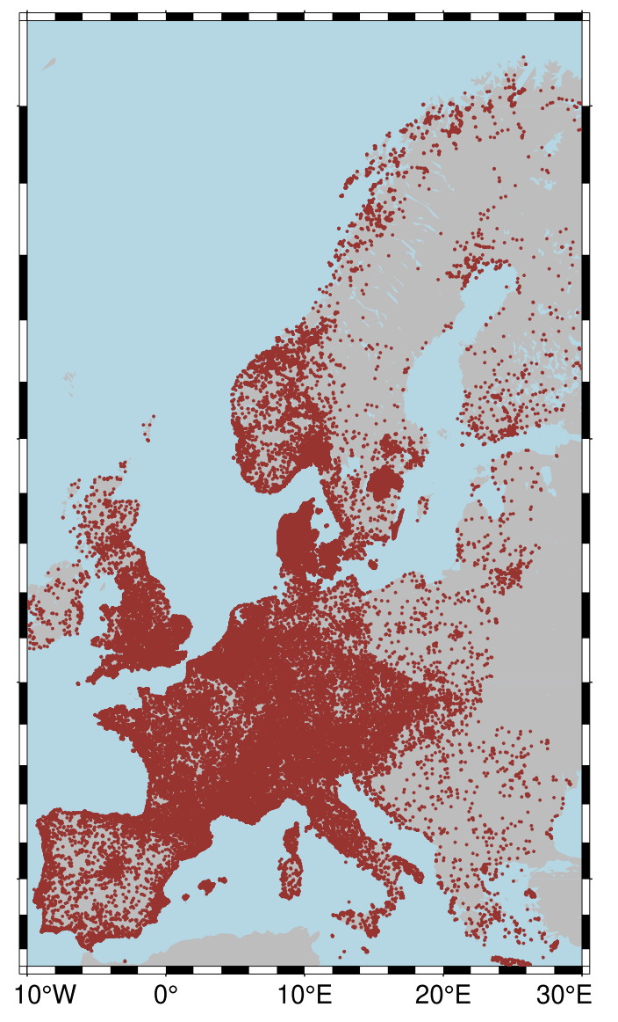
Data Availability
PA-Data
PO-Data
PA data is geographically limited, but more valuable for inference and evaluation
PO data has much wider geographical coverage, but comes with significant biases
GeoLifeClef 2023 (Botella et al.)

Slide 16
How can we test model performance in areas where PA-data is not available?

Slide 17







$$𝒟_{PO}$$
$$𝒟_{PA}$$
$$𝒟_{PA}^{train},𝒟_{PA}^{test}$$
Traditional random train-test split
Induce bias in the test set and assign different training splits
$$closest$$
$$middle$$
$$farthest$$
$d(𝒟_{PA}^{train},𝒟_{PA}^{test}$)

Slide 18
We can test different sampled splits using this methodology
applied to the same Dataset

Slide 19
Results

Slide 20

Takeaway (or dine in)
Both PO Data and PA Data are valuable for SDMs
Integration generally helps performance, even when prediction is far
No integration method (yet) generally outperforms the others

Slide 21
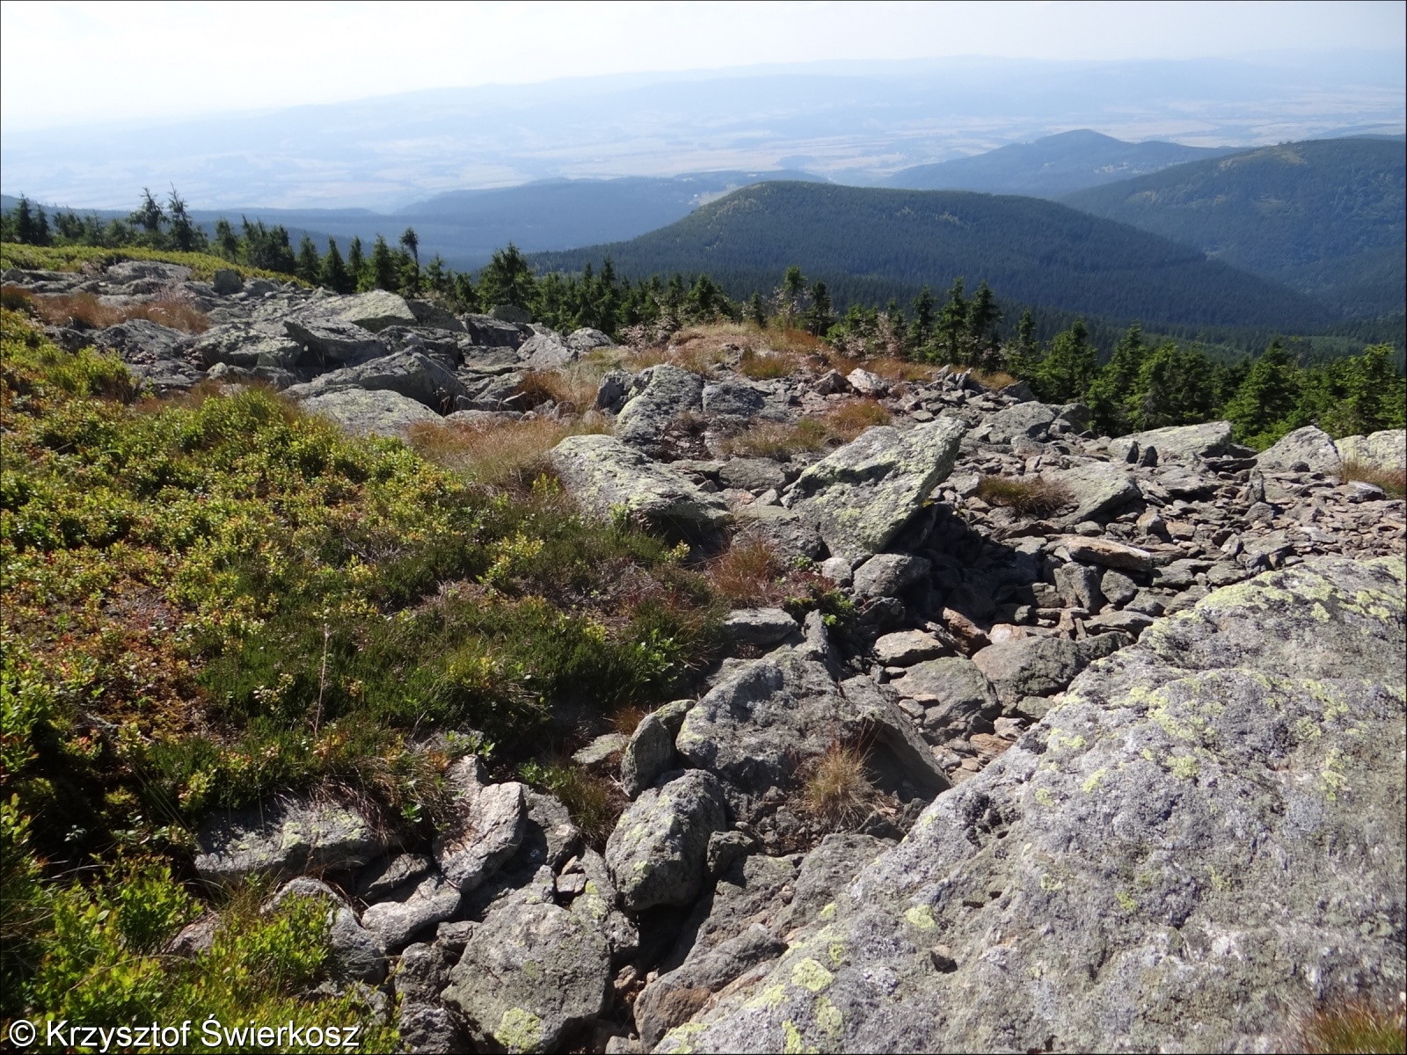



Many Thanks, Merci Beacoup, Muchas, Gracias, Vielen Dank
Pablo Ubilla Pavez
Christophe Botella
Diego Marcos
Preprint coming eventually…
pablo.ubilla-pavez@inria.fr
pablo.ubilla-pavez@inria.fr

